Slide 1
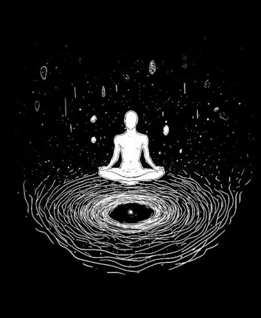
holiday.com
Opening the session
INTRODUCTION
Before we dive into the deep-rooted psychological dynamics of sales, let's establish our foundation.
This session is designed to fearlessly explore the evolution of persuasion—from ancient narratives to modern AI-first environments.
"Great things in business are never done by one person. They're done by a team of people."
Notes:
Establish the session's foundation before exploring deep-rooted sales psychology.1
We will fearlessly trace persuasion's evolution from ancient narratives to AI environments.1
Great business achievements are always done by a team of people, not one individual.

Slide 2
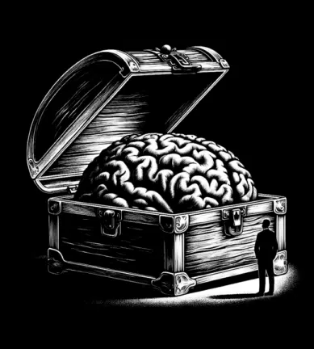
holiday.com
WHAT IS
$ALES?
Notes:
Sales is the art and science of human persuasion and value exchange.1
It involves enabling a transformation from the current state to a desired future.1
Every interaction is a psychological bridge between a problem and a solution.

Slide 3
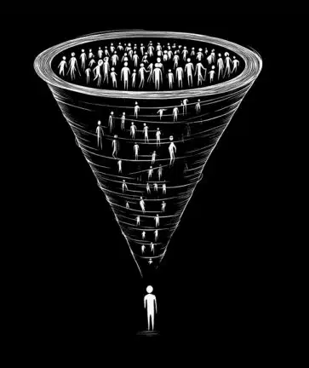
holiday.com
Defining the discipline
WHAT REALLY IS SALES?
Sales is not just a transaction; it is the art and science of human persuasion and the exchange of value.
It is about identifying a need, reframing perspectives, and enabling a transformation from a current state to a desired future.
"At its core, every sales interaction is a psychological bridge between a problem and a solution, built on trust and strategic communication."
Notes:
Sales is the art and science of human persuasion and value exchange.1
It involves identifying a need and reframing perspectives to a desired future

Slide 4

holiday.com
Perspective & agnostic intent
DISCLAIMER
Biblical references used here are not intended to attack or degrade any religious groups, cultures, or beliefs.
From an agnostic viewpoint, these references serve as a fearless anchoring of glaring narrative facts found within the ancient written text that existed for millennia. “To explore deep-rooted psychological dynamics of the human mind and the first recorded sales transaction.”

Slide 5

holiday.com
The masterclass in persuasion
THE FIRST "CLOSE"
While historians look to Mesopotamian markets, the silk road, and so on… The true black and white origin of sales traces back to a garden and a masterclass in persuasion.
Setting: The Garden of Eden
Salesperson: The Serpent
Prospect: Eve
Product: The Apple (Knowledge)
“The first closed-won happened in the Garden of Eden, when the serpent pitched the world to Eve.”
Notes:
Biblical references are not meant to attack or degrade any religious groups or beliefs.1
We use these references from an agnostic viewpoint, focusing on narrative facts from ancient text.1
The goal is to explore the deep psychological dynamics of the first recorded sales transaction

Slide 6
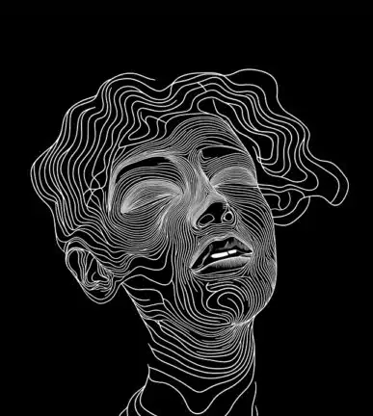
holiday.com
The anatomy of the first pitch
ANATOMY OF THE ORIGINAL PITCH
The Serpent utilized core principles that drive modern sales funnels:
Identifying the "Pain Point": Gap between where Eve was and where she could be.
Reframing the Objection: Serpent used Objection Handling to reframe "risk" as opportunity.
The Value Proposition: Focus on ROI of transformation over cost of transaction.
Creating Urgency: Triggered the first recorded instance of FOMO.
Notes:
The pitch identified the "Pain Point" by showing the gap between current and potential.1
Objection Handling reframed the perceived "risk" of the transaction as an opportunity.1
The Value Proposition focused on the ROI of transformation over the cost of the transaction.1

Slide 7
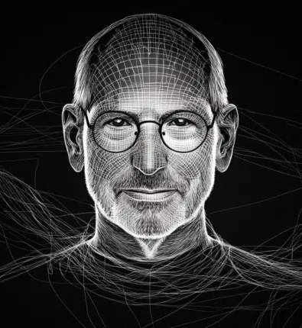
holiday.com
Sales core principles
FROM EDEN TO BOARDROOMS
To understand sales is to understand the Apple and the Serpent as metaphors for the buyer-seller dynamic:
1. The Apple (The Solution): Every product is an "Apple." It represents the promise of a "New Better"—a bridge to a desired state of being.
2. The Serpent (The Consultant): Represents the Catalyst. Moving a prospect from "Status Quo" to "Action" through narrative.
3. The Result (The Exchange): Eve traded security for an upgrade. This highlights that value is subjective—therefore, perceived.
Notes:
The Apple represents the solution, promising a "New Better"—a bridge to a desired state of being.
The Serpent is the consultant, acting as the catalyst to move a prospect from "Status Quo" to "Action" via narrative.
The Result of the exchange demonstrates that value is subjective, as Eve traded security for a perceived upgrade

Slide 8
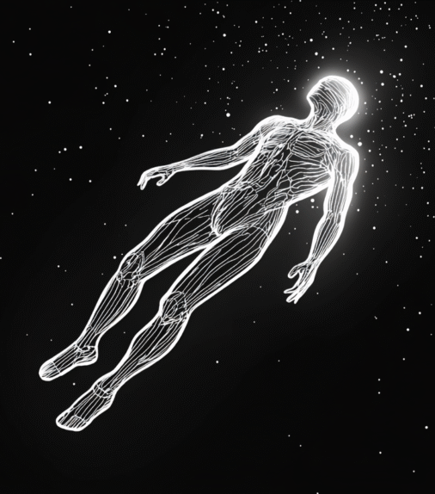
holiday.com
Closing thought about the fall
ETERNAL PSYCHOLOGY
Eve’s encounter with the serpent and the fruit, in the Garden of Eden teaches us that sales is not merely an economic activity; it is a deeply-rooted human psychological encounter.
It is the process of painting a vision so compelling that the prospect is willing to cross a threshold they previously feared.
“The tools have changed since the beginning of time, but the essential psychology of closing a sale remains eternal.”
Notes:
Sales is a deeply-rooted human psychological encounter, moving beyond just economic activity.1
It requires painting a vision so compelling that the prospect is willing to cross a feared threshold.1
While tools change, the essential psychology of closing a sale remains eternal

Slide 9

holiday.com
The journey ahead
THANK YOU
The first close redefined our history, but your next close defines your future.
May today’s introduction and mind session fuel our visions of a future worth crossing the threshold for.
—phillip.tagarda@kape.com
Notes:
Thank the audience and reinforce the session's core purpose.
The first recorded 'close' is history, but their next sale defines their future.
Inspire the audience to use today's insights to cross their next threshold.

